Slide 1
SEL Blueframe Python SDK, Sprint 5
Caleb Hansen, Genevieve Kochel
Darron Li, Lucas Phillips
CptS 423, Team 03-SEL-BFSDK
Client Joe Stanley, SEL
October 2026
Notes:
Lucas Phillips presents this slide, about 15 seconds.
Say the project name and the course, and that this is the Sprint 5 walkthrough. Each section is presented by a different person.

Slide 2
Introduction
The project
Blueframe apps send grid data through Signal Hub. SEL has Go and C# clients, but most engineers write Python.
The SDK wraps an existing client, so SEL never has to maintain a third copy.
Lucas Phillips
Bindings on the bridge, Python.NET tests, docs
Caleb Hansen
Test harness owner, repo and CI
Sprint 5 goal
Python bindings that a script can import to publish and subscribe, with automated tests, compatibility results and user docs.
Genevieve Kochel
C# client evaluation and user docs owner
Darron Li
Cross-platform validation and compatibility roadmap
Notes:
Lucas Phillips presents this slide, about 45 seconds.
Give the project in one line, then introduce each person and their Sprint 5 role. End with the Sprint 5 goal.

Slide 3
Sprint Objectives
1. Python bindings
A Python program imports the wrapper and uses publish and subscribe.
2. Automated tests
Normal use, errors, limits and concurrency, run automatically.
3. Compatibility
The agreed Python version and operating systems, with test logs.
4. User docs
Install, setup, API and a pub/sub example a developer can follow.
Why these
Joe agreed on September 28 to move to the C# client and keep the Go bridge as the fallback.
Sprint 6 is the handoff, so the SDK has to be tested and documented now.
Long term vision
Engineers script Signal Hub from Python with numpy in and out.
SEL keeps one client, and the Python layer only translates.
Notes:
Caleb Hansen presents this slide, about 45 seconds.
Go through the four deliverables from the Sprint 4 to 6 plan. The reason behind them is Joe's rule against double maintenance, so the SDK wraps a client instead of porting it. Long term, engineers should be able to script Signal Hub from Python with numpy.

Slide 4
Feature Implementation and Demonstration
Issue | Feature | Owner | Status | Points
#44 | Bridge hardening and crash recovery | Lucas | Done | 8
#45 | Demo app for the SDK | Lucas | Done | 3
#46 | Python.NET evaluation with a stand-in C# class | Lucas | Done | 3
#48 | User guide and pub/sub example | Lucas | Done | 3
#49 | Compatibility matrix | Lucas | Done | 2
#52 | Test harness CI evidence | Caleb | Done | 2
#36 | C# client evaluation | Genevieve | Open, client not available | 5
#53 | User guide review | Genevieve | Done | 2
#54 | Cross-platform compatibility roadmap | Darron | Done | 3
The bridge and demo code is in the private gosignals repo because the client is SEL Confidential.
Notes:
Lucas Phillips presents this slide, about 30 seconds.
Each member names their own issues. Caleb shows the team CI run (#52). Genevieve covers the C# evaluation status and the user guide review (#36, #53). Darron covers the compatibility roadmap (#54). Lucas demos the bridge, the pub/sub example and the Python.NET results on the next slides.

Slide 5
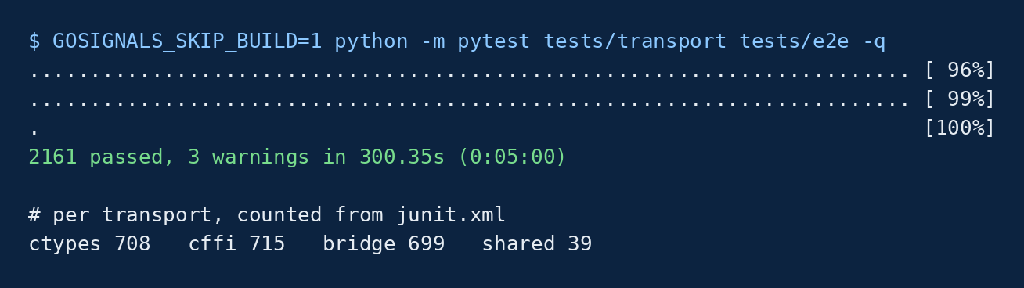
Bridge Crash Recovery
What changed (#44)
In Sprint 4, a Go crash in the bridge ended every subscription.
Now auto_restart starts a new bridge, and subscriptions resume from the last timestamp with no gaps or duplicates.
A duplicate client name fails at once with a clear error, and unique_name=True avoids it.
A forked child gets a clear error instead of hanging.
A Python timeout cancels the call in Go.
30
0
new end to end tests for the bridge
lost or duplicate samples after a restart in the tests
2,161
300 s
tests passing on all three transports, Oct 30
full suite run time
Notes:
Lucas Phillips presents this slide, about 1 minute.
In Sprint 4 a dead bridge raised an error and every open object was lost. Now, with auto_restart=True, the SDK starts a new bridge and picks up where it left off. This is backed by 17 hardening tests and 13 name and cancel tests, and all of them passed in the October 30 run.

Slide 6
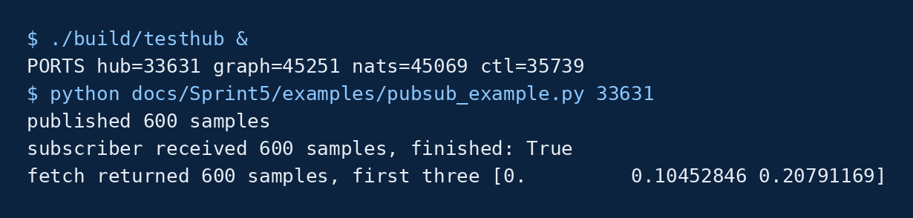
Publish and Subscribe Demo
Demo app (#45)
Publishers, the hub and subscribers are on one local page.
Subscribers find signals on the Graph and subscribe.
Every SDK call is timed.
Kill bridge shows the SDK restarting and resuming.
Deliverable 1 check
The script imports gosignals, publishes 600 samples, gets all 600 through a callback, and fetches them back.
Nothing in the script mentions Go, gRPC or processes.
Notes:
Lucas Phillips presents this slide, about 45 seconds.
For the live demo, start build/testhub, then run docs/Sprint5/examples/pubsub_example.py with the hub port. Then open the demo app with PYTHONPATH=python python3 demo/server.py at http://127.0.0.1:8765. Add a publisher and a subscriber, send a batch, and press Kill bridge to show the recovery. If it is not live, show the captured output.

Slide 7
Python.NET Evaluation
Works
Generic Publish[Single] called straight from Python
Callbacks from a C# thread reach Python
C# exceptions turn into Python exceptions
6 of 6 tests pass on Linux and Windows
2.8 us
316k+
Does not work
A fatal .NET error kills the Python process (exit -6), like ctypes.
SEL's C# client itself is still untested (#36).
per plain call from Python
callbacks/s from a C# thread
Notes:
Genevieve Kochel presents this slide, about 1 minute 15 seconds.
The C# client was not on our machines, so Lucas measured Python.NET with a stand-in C# class that has no SEL code in it. Generics and callbacks were most of the Go glue work, and here they need no glue at all. The catch is that a fatal .NET error still kills Python, the same as ctypes, which is why the Go bridge stays as the fallback. The numbers are from local runs on October 30.

Slide 8
Deployment of the System
1. Developer machine
Our VS Code extension extracts the Field SDK and opens its devcontainer.
Built in Sprint 3
2. SDK in the container
The bridge build today, and pythonnet plus the C# client after the move.
Runs locally and in CI
3. Blueframe app
The script and SDK are packaged and signed with the Field SDK tooling.
Not done, needs SEL signing
4. Device
The app talks to Signal Hub on the same device.
Not done, needs hardware
Open questions for SEL
Can a Blueframe app start a child process, which the Go bridge needs? Is .NET in the app container? Which Python is in the Field SDK image?
Notes:
Caleb Hansen presents this slide, about 1 minute 15 seconds.
Blueframe runs signed, containerized apps on SEL-3350, 3355 and 3360 computers. Walk through the four steps. Steps 1 and 2 are done on developer machines and in CI. Steps 3 and 4 need SEL's signing process and a device or a virtual Blueframe instance, which the team does not have yet. That is the first Sprint 6 request to Joe.

Slide 9
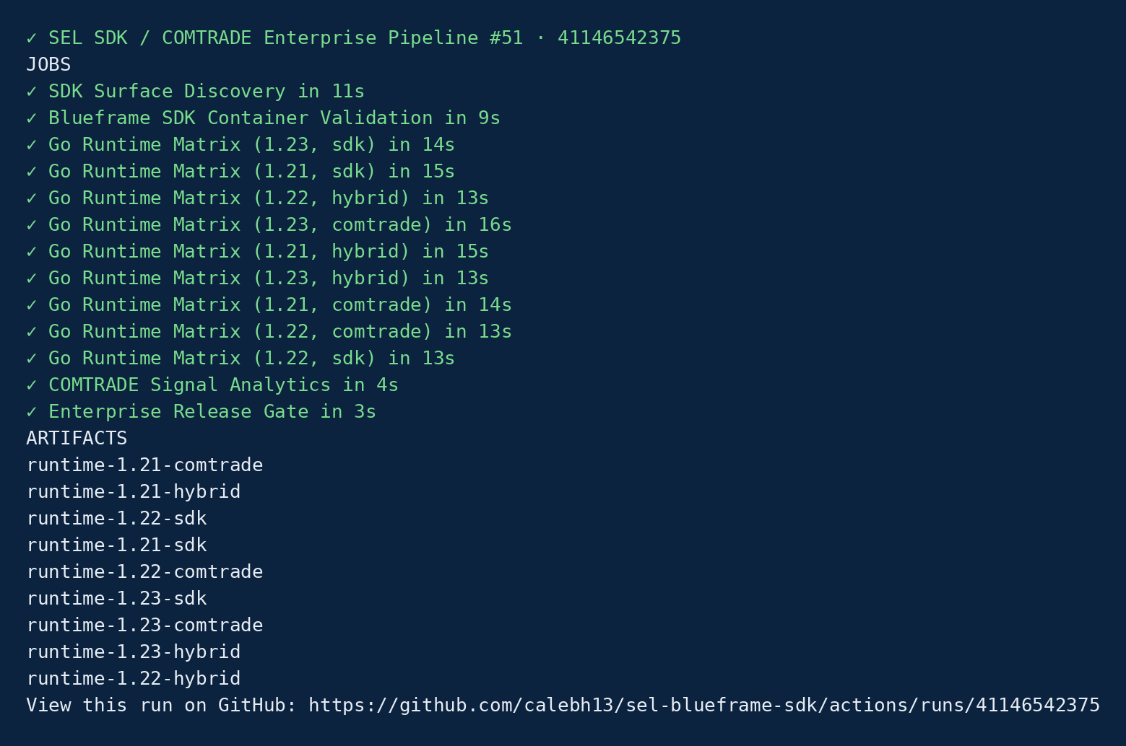
Deployment CI/CD and Compatibility
Compatibility (#49)
Python 3.12 is the agreed baseline.
The Python.NET tests pass on Linux and Windows with Python 3.10, 3.12 and 3.13.
The team pipeline covers Go 1.21, 1.22 and 1.23.
The Go bridge has only run on Linux so far.
Notes:
Caleb Hansen presents this slide, about 45 seconds.
Show the team CI pipeline run on the Sprint 5 branch, run 41146542375, where 13 of 13 jobs passed. It runs on every push and pull request. Then show the compatibility matrix in docs/Sprint5.

Slide 10
User Testing and Feedback from the Client
Functional
2,161 tests over publish, subscribe, history, discovery and rates
The pub/sub example run end to end
Reliability and speed
The bridge was killed mid stream and resumed with no loss
Fork, Ctrl+C, timeouts and duplicate names were tested
Python.NET call cost and callback rate were measured
Client feedback
On September 28 Joe said a crashed Python session is not acceptable, and Sprint 5 bridge recovery answers it.
<placeholder> October feedback from the MoMs </placeholder>
Not tested on SEL's own Signal Hub yet.
Notes:
Genevieve Kochel presents this slide, about 45 seconds.
The integration and system tests run the SDK against the fake Signal Hub, which speaks the same wire protocol as SEL's hub. On September 28 Joe said crashing an engineer's Python session is not acceptable, and the bridge recovery is the answer to that. October feedback is in the MoMs.

Slide 11
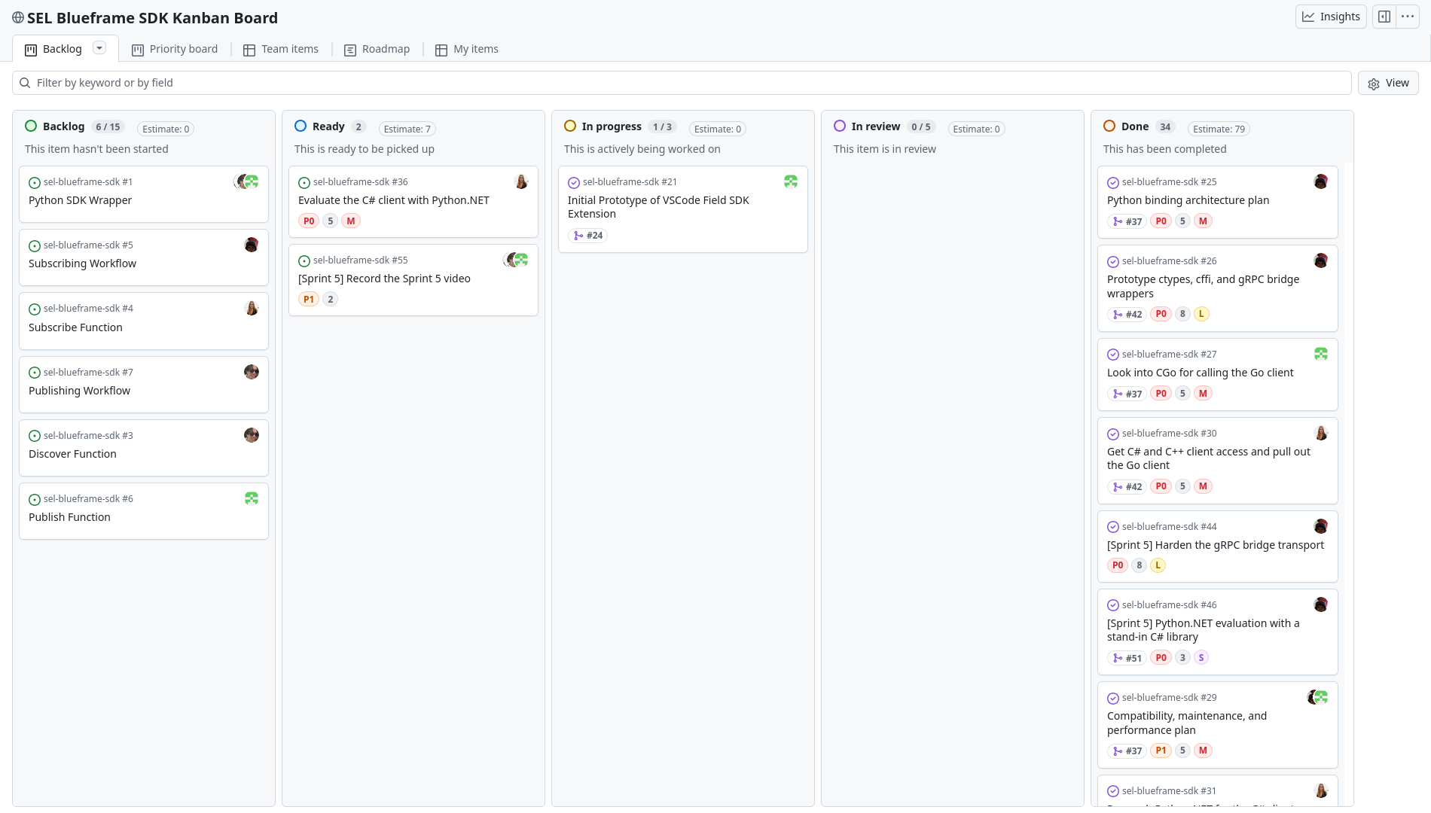
Kanban Overview & Team Contributions
Sprint 5 issues
Lucas has #44 to #46 and #48 to #50
Caleb has #52
Genevieve has #36 and #53
Darron has #54
Everyone shares #55, the video
Every issue has an owner, a milestone, a priority and a story point label.
Notes:
Darron Li presents this slide, about 45 seconds.
Show the board. Done has #44 to #46, #48 to #50 and #52 to #54. Ready has #36 and #55. Each member names their issues.

Slide 12
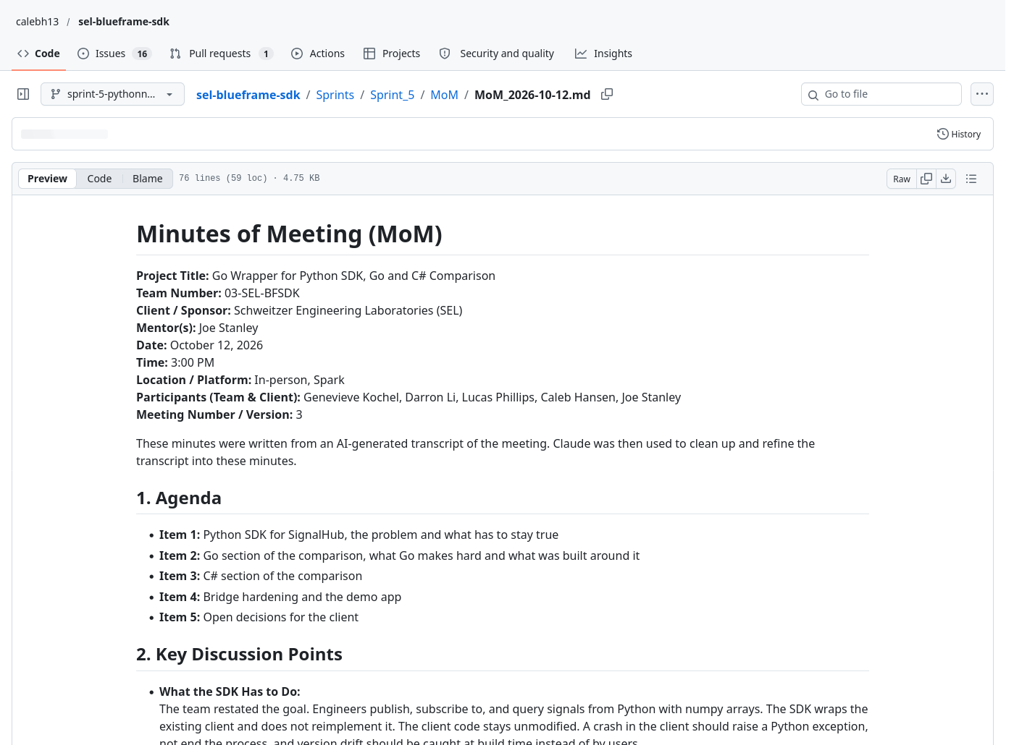
Evidence of MoM with Clients
October 12, Go and C# comparison
What Go makes hard, which is generics, callbacks and process ownership
Bridge hardening and the demo app
Open decisions and a request for SEL's Signal Hub
October 26, Sprint 5 review
The C# client is still not available (#36)
Status of the bindings, tests and CI
Deployment needs and the Sprint 6 plan
Notes:
Darron Li presents this slide, about 45 seconds.
Open Sprints/Sprint_5/MoM on GitHub. The files follow the Sprint 4 format. October 12 was the Go and C# comparison, and October 26 was the Sprint 5 review.

Slide 13
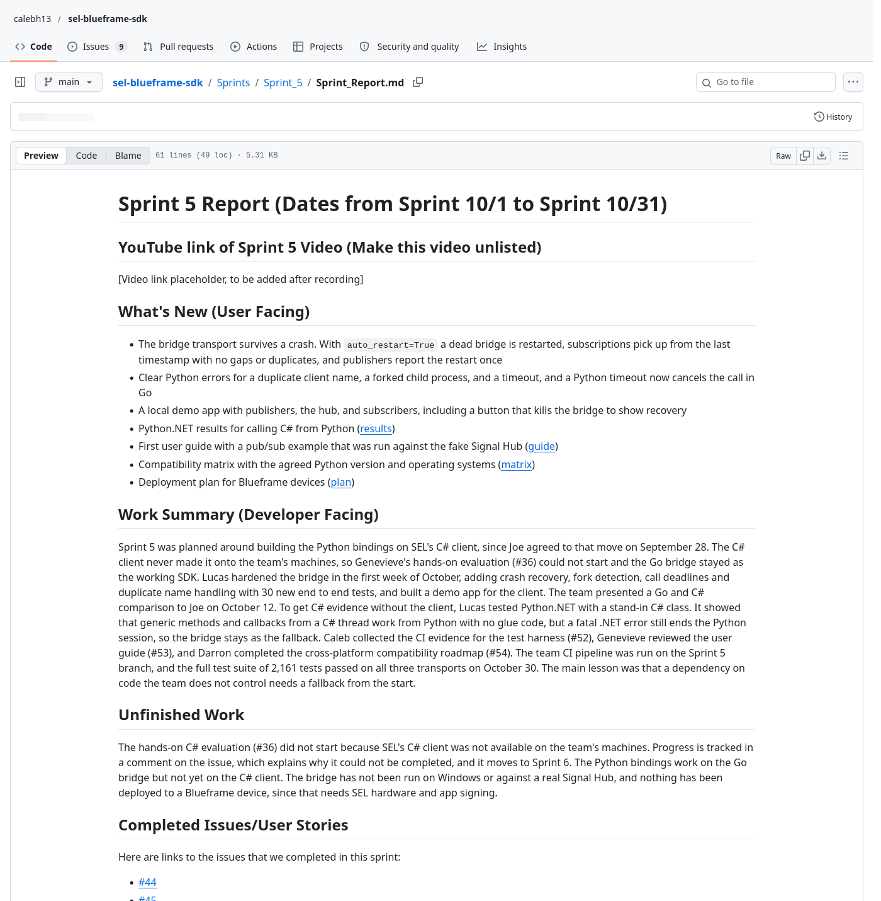
Documentation of Report
Sprint 5 report
Course template sections and issue lists
docs/Sprint5
User guide, compatibility matrix and deployment plan
Python.NET tests
Stand-in C# class, tests and results in code/
Final report
New section V with test specifications and results
README
Install steps checked on a fresh clone
Notes:
Lucas Phillips presents this slide, about 1 minute 15 seconds.
Scroll through Sprints/Sprint_5/Sprint_Report.md on GitHub and point out the issue lists and the retrospective. Then show the new section V in the final report, the docs/Sprint5 folder and the README.

Slide 14
Responsible Use of AI
How it was used
Claude, through Claude Code, was the tool used
Python.NET test code and its tests
First drafts of the user guide, matrix, deployment plan, report and slides
Rerunning tests and reading numbers out of logs
Cleaning up meeting transcripts into MoMs
Limits and accountability
The first Python.NET run failed because a folder name hid the .NET namespace. Running it caught that.
Every number in the report comes from a test log or a CI run.
MoMs are written from AI transcripts and checked by the team.
SEL code stays in the private repo.
The team reviewed everything and is responsible for it.
Notes:
Caleb Hansen presents this slide, about 1 minute 30 seconds.
Say that Claude was used for the Python.NET test code, doc drafts, the report and the slides, and to pull numbers out of logs. Give the example of an AI mistake that running the code caught. Every number comes from a log or a CI run, SEL code never went to a public tool, and the team owns every deliverable.

Slide 15
Sprint Achievements and Challenges
Achievements
The bridge recovers from crashes, with tests to show it
2,161 tests pass, up from 2,155
The team CI pipeline is green on the Sprint 5 branch
There is a first user guide and pub/sub example
Challenges and fixes
There was no C# client, so the bridge was kept and Python.NET was tested with a stand-in class.
There is no SEL Signal Hub to test on, so all tests use the fake hub.
SEL code is private, so results are shared and code is not.
Progress from Sprint 4
Sprint 4 picked the bridge as the only safe Go transport
Sprint 5 made it recover from crashes
The C# question now has measured answers for everything except the client itself
Notes:
Genevieve Kochel presents this slide, about 45 seconds.
Go through the achievements, then each challenge and what was done about it. Close with how Sprint 5 built on Sprint 4.

Slide 16
Next Steps and Sprint Retrospective
Sprint 6
Get the C# client and finish #36
Run the bridge on Windows
Deploy to a Blueframe device or virtual instance
Put the prototype suite in private CI
Final docs and handoff
Retrospective
The fallback plan and writing tests before fixes went well
Next time the client should be requested in writing with a date
Every member's work should be on the board and code pushed weekly
Client feedback acted on
The SDK still wraps the client and does not port it
Bridge recovery keeps Python sessions alive
Python.NET is measured and the C# client is next
Docs are a deliverable, so there is a user guide
Notes:
Darron Li presents this slide, about 45 seconds.
Start with the Sprint 6 plan, then what went well and what to change. End with what was done because of Joe's feedback.

Slide 17
The SDK works and recovers on the Go bridge, and the C# path is measured and ready for the client
Thank you to Joe Stanley and SEL, and to the course staff.
Notes:
Lucas Phillips presents this slide, about 30 seconds.
Recap the working SDK on the bridge with crash recovery, the team CI pipeline, the measured C# results and the first docs. Sprint 6 is the C# client and deployment. Thank Joe, SEL and the course staff, and invite questions.

